Slide 1
DevOps Basic
What is DevOps
Why DevOps
Waterfall Model Phase
Advantages and Disadvantages
What is Agile
Agile Process
Advantages of Agile Model
Disadvantages of Agile Model
DevOps Life cycle
continuous development
continuous integration
continuous testing
continuous deployment
continuous monitoring
DevOps tools

Slide 2
What is DevOps
The word DevOps is a combination of two words Development and Operations.
The development team is responsible for developing, designing, and building the application.
The operation team deals with the deployment and testing of the application.
If there are problems with the application, the operation team also provides feedback to the development team.

Slide 3
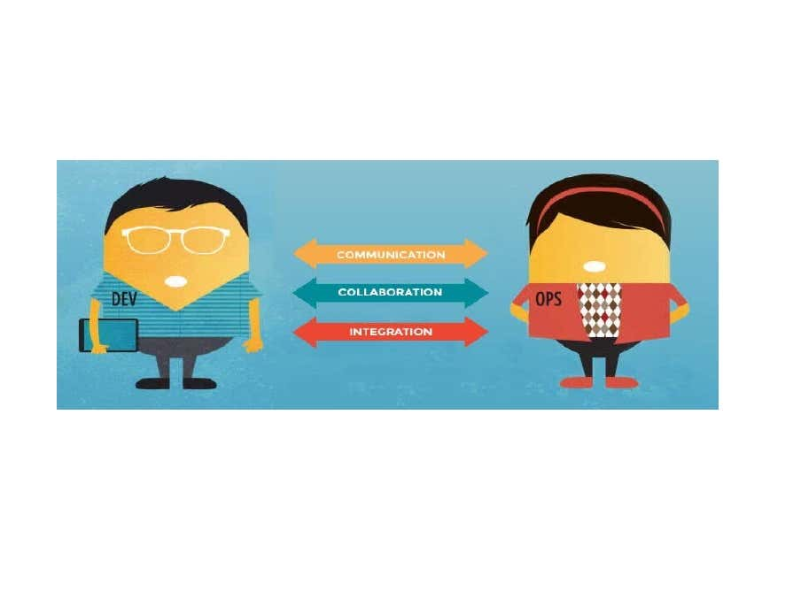

Slide 4
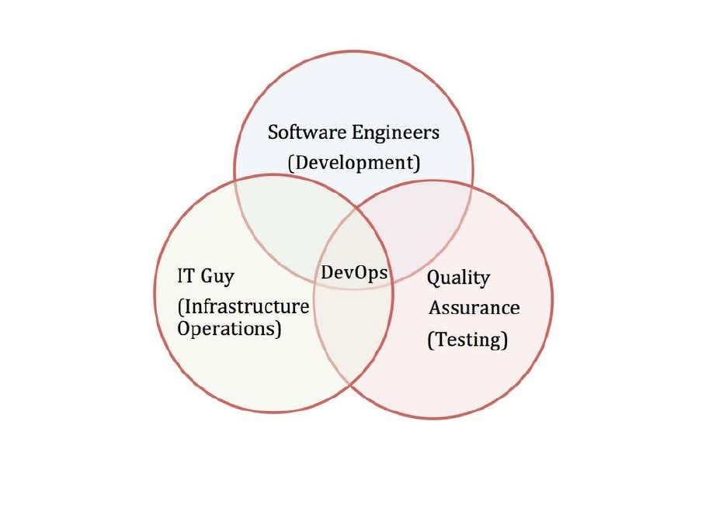

Slide 5
Why DevOps?
The problems faced in traditional models like in the waterfall model there is a problem of a one-way stream of work.
If there is any mistake, the whole process repeats and there is no interaction with customers.
This is solved in agile by splitting the whole development plan into several iterations for a better level of production efficiency.
The agile model also includes customer interaction with the company to rectify the mistakes.
But there is another problem faced in Agile too.

Slide 6
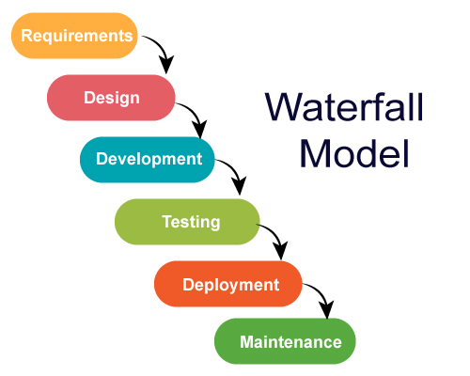

Slide 7
Waterfall Model Phase
phase 1 – Complete Requirement is gathered and SRS is developed
phase 2 – This System is Planned and Designed using the SRS
phase 3 – Implementation of the System takes place
phase 4 – System is tested and its quality is assured
phase 5 – System is deployed to the end users
phase 6 – Regular Maintenance of the system is done

Slide 8
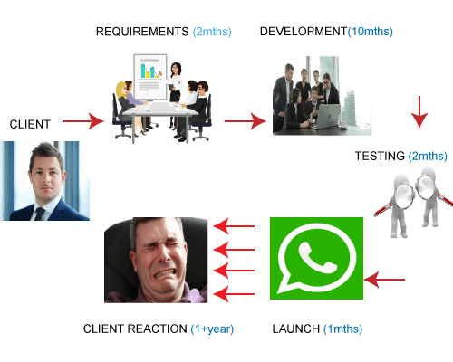

Slide 9
Advantages and Disadvantages
Advantages of the Waterfall model
Simple and easy to understand and use
Specific deliverable and review process
Phases do not overlap
Good for small projects if all requirements are clearly defined
Allows for departmentalization & managerial control
Disadvantages of the Waterfall model
Time to market is high
Unexpected results
Lack of visibility of the current progress
Not suitable when the requirements keep changing
Difficult to make changes to the product when it is in the testing phase
The end product is available only at the end of the cycle
Not suitable for large and complex projects

Slide 10
What is Agile?
Agile is a philosophy, i.e., a set of values and principles to make a decision for developing software.
Agile is based on the iterative-incremental model.
In an incremental model, we create the system in increments, where each increment is developed and tested individually.

Slide 11
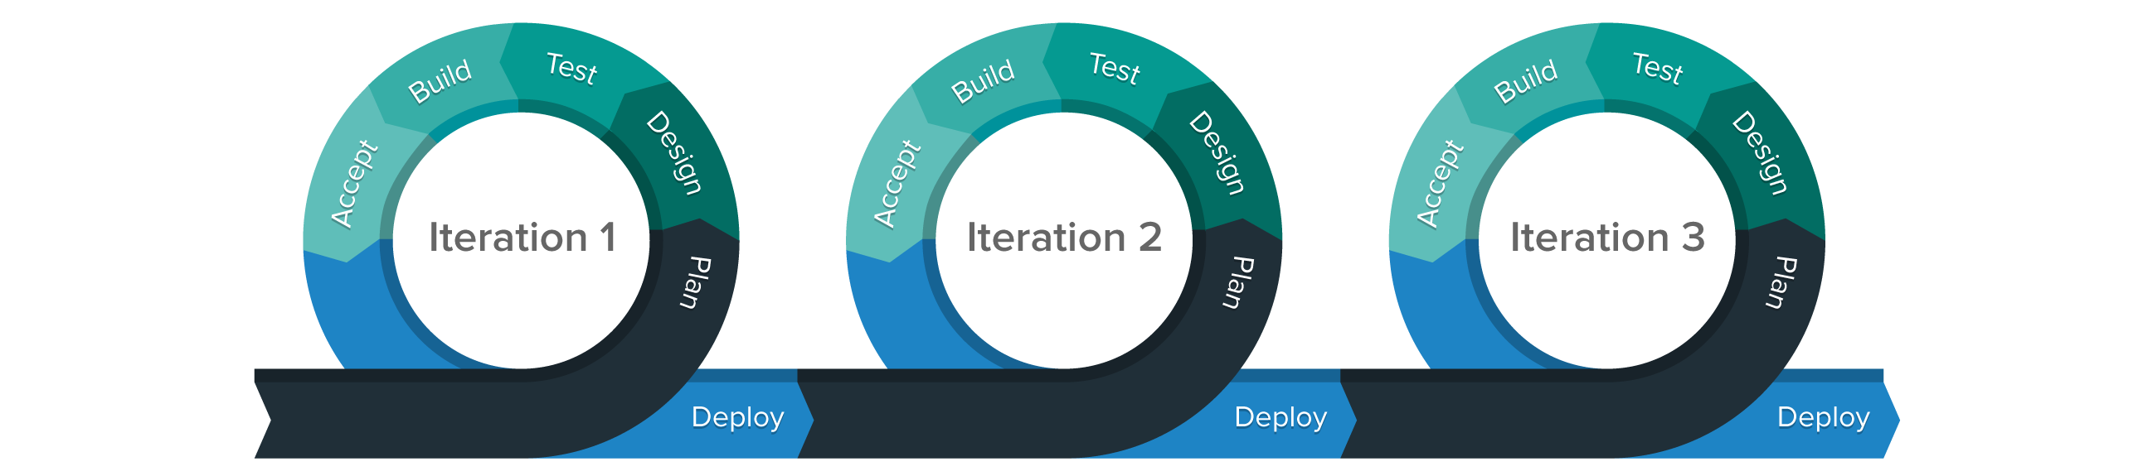

Slide 12
Agile Process
In Agile, a company releases the application with some high priority features in the first iteration.
After its release, the end-users or the customers give you feedback about the performance of the application.
Then you make the necessary changes into the application along with some new features and the application is again released which is the second iteration.
You repeat this entire procedure until you achieve the desired software quality.

Slide 13
Advantages of Agile Model
It adaptively responds to requirement changes
Fixing errors early in the development process and makes this process more cost-effective
Improves the quality of the product and makes it highly error-free
Allows for direct communication between people involved in software project
Highly suitable for large & long-term projects
Minimum resource requirements & very easy to manage

Slide 14
Disadvantages of Agile Model
Highly dependent on clear customer requirements
Difficult to predict time and effort for larger projects
Not suitable for complex projects
Lacks documentation efficiency
Increased maintainability risks

Slide 15
DevOps Life cycle
continuous development
continuous integration
continuous testing
continuous deployment
continuous monitoring

Slide 16
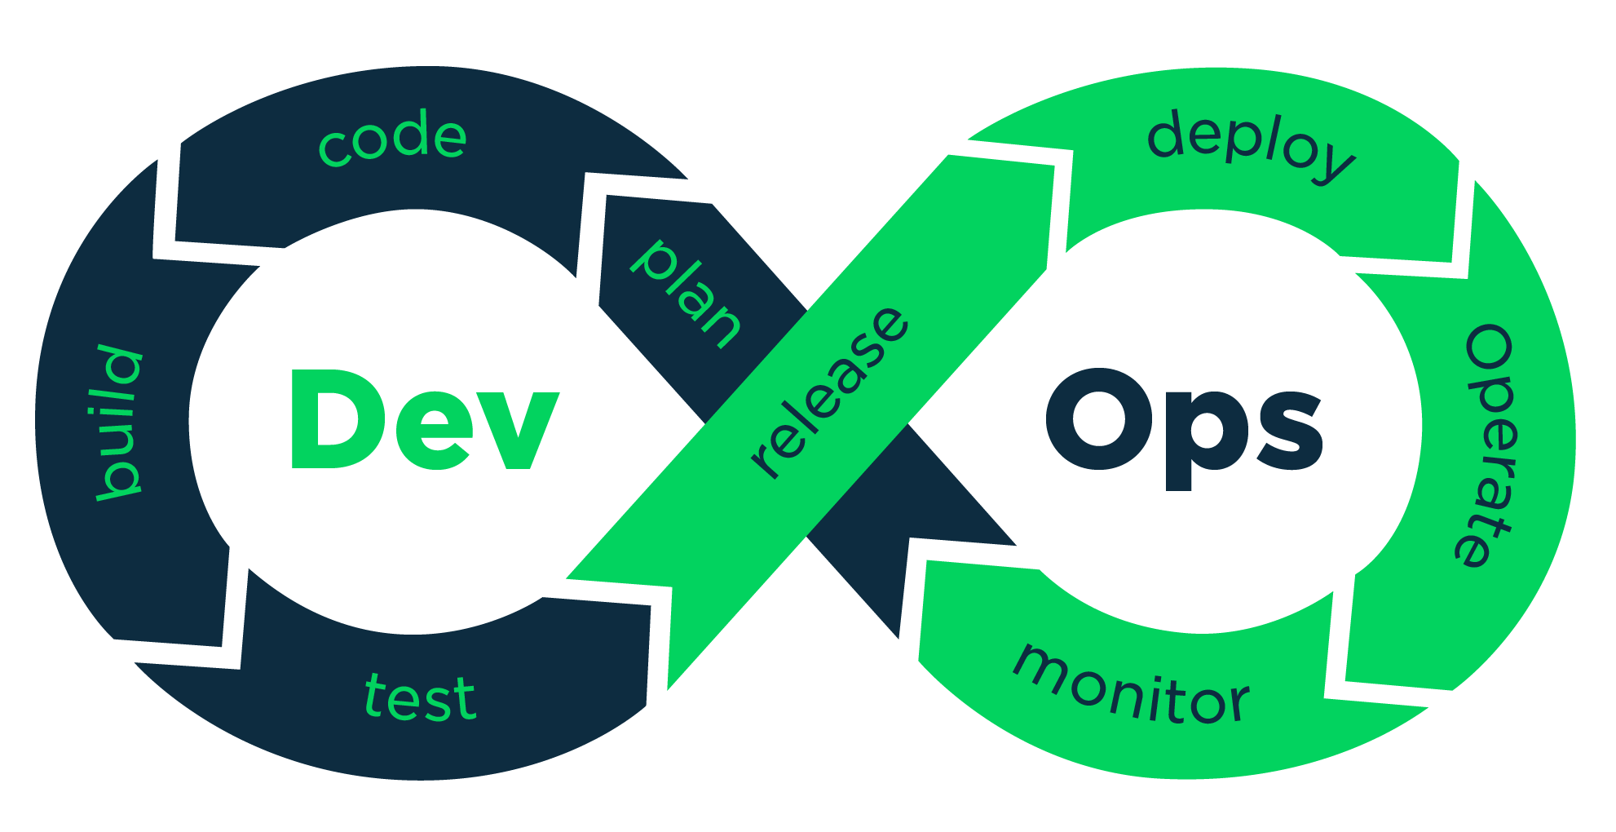

Slide 17
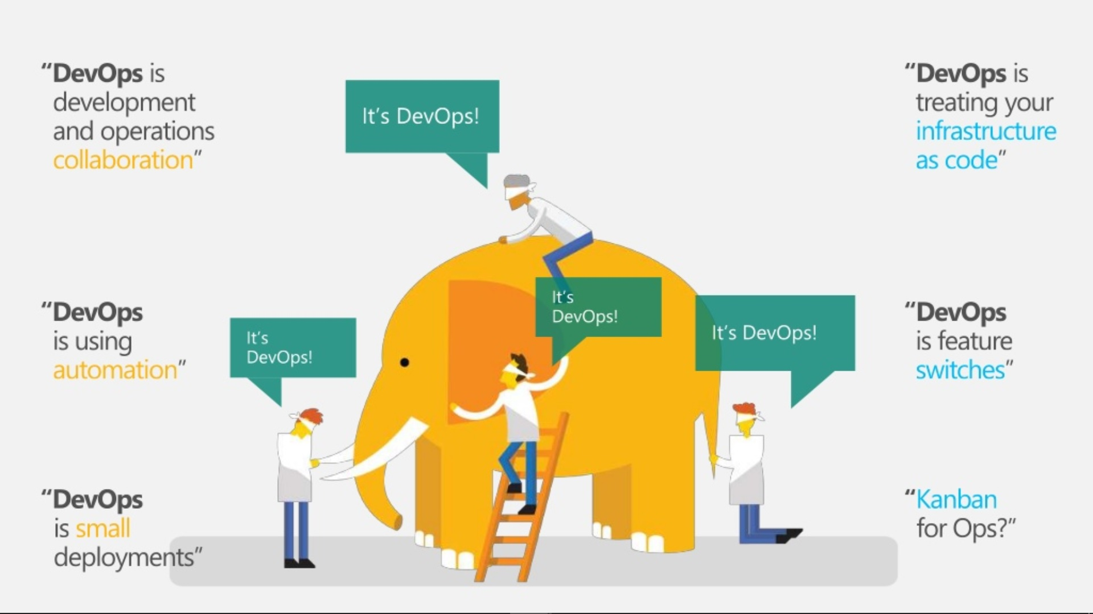

Slide 18
Continuous Development
‘Planning‘ and ‘Coding‘ Stage.
The code can be in any language, but you maintain it by using Version Control tools.
This process of maintaining the code is known as Source Code Management.
After the code is developed, then you move to the Continuous Integration phase.
Git, SVN, CVS

Slide 19
Continuous Integration
This stage is the core of the entire DevOps life cycle.
Require to commit changes to the source code more frequently.
This may be either on a daily or weekly basis.
You then build every commit and this allows early detection of problems if they are present.
Building code not only involves compilation but it also includes code review, unit testing, integration testing, and packaging.
Jenkins, GitLab

Slide 20
Continuous Testing
Test the developed software continuously for bugs using automation testing tools.
These tools allow QAs to test multiple code-bases thoroughly in parallel to ensure that there are no flaws in the functionality.
In this phase, you can use Docker Containers for simulating the test environment.
Jenkins, Selenium TestNG, JUnit

Slide 21
Continuous Deployment
Configuration Management – Chef, Puppet, Ansible
Containerization – Docker, Vagrant

Slide 22
Continuous Monitoring
Tools Used: Splunk, ELK Stack, Nagios, New Relic

Slide 23
